Slide 1


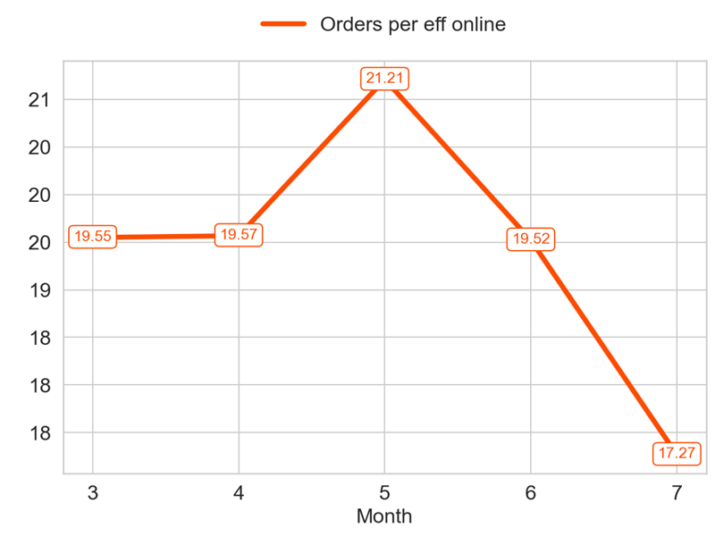
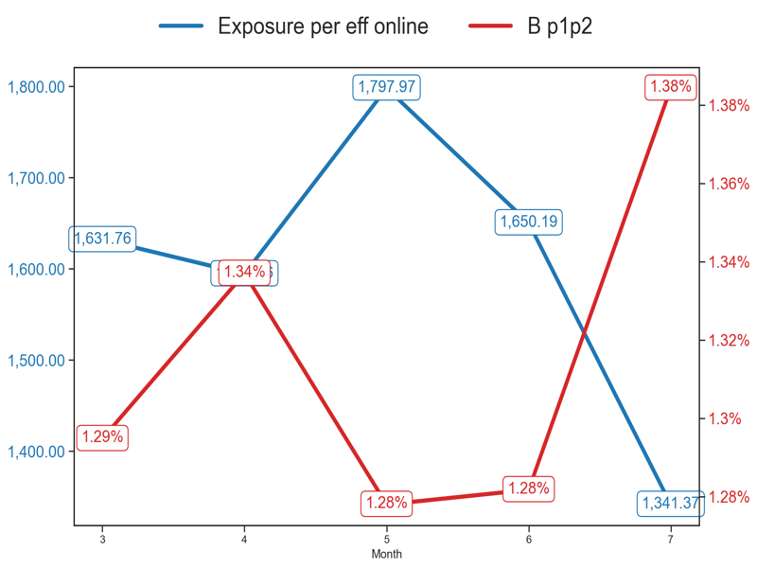
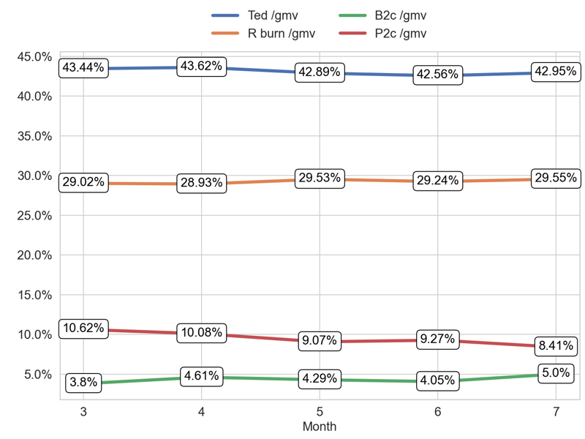
PERFORMANCE
Action Title
Priority 1 -
Insights
Mean over the last 4 months: 19.39
Example text
Example text

Slide 2
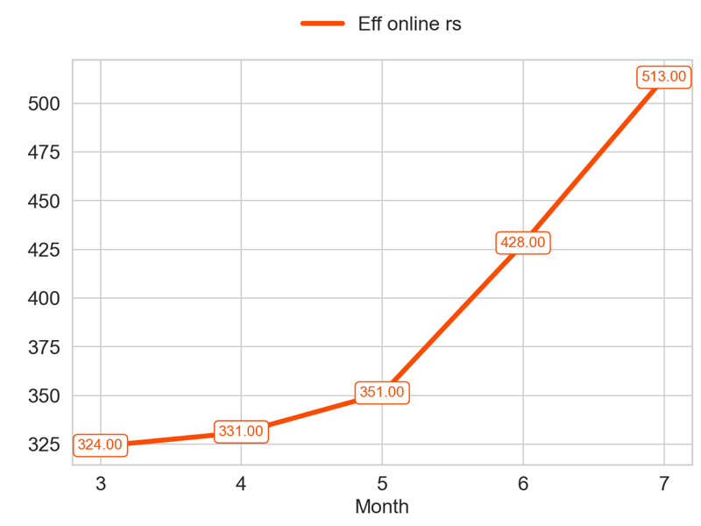
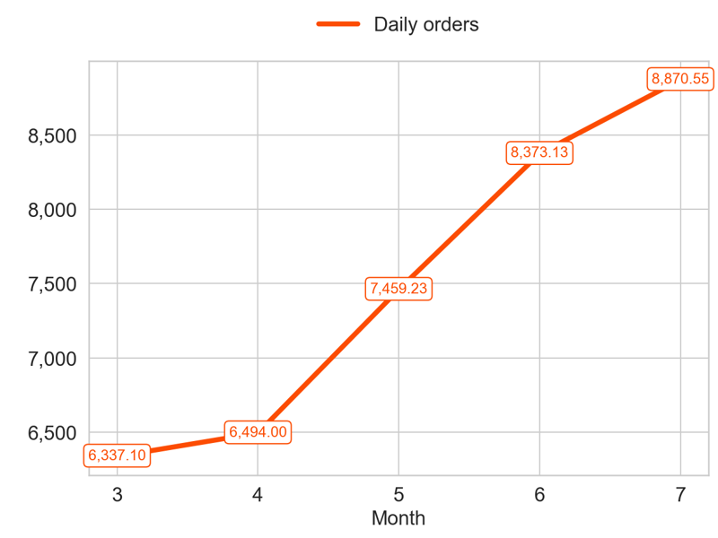
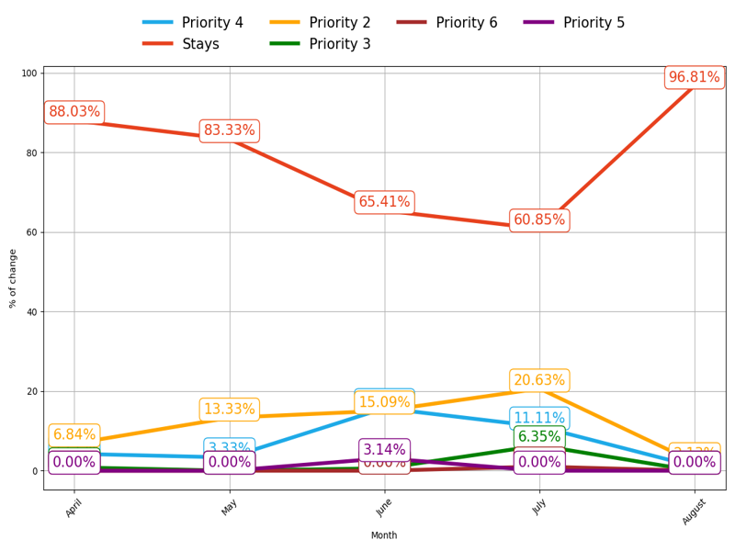
MIXED
Action Title
Priority 1 -
Insights
Mean over the last 4 months: 405.75
Mean over the last 4 months: 7799.23
Example text

Slide 3
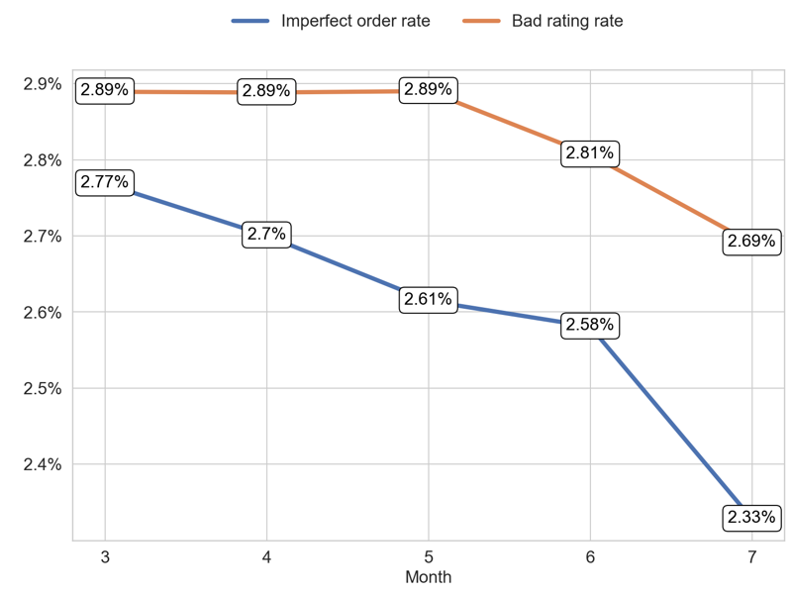
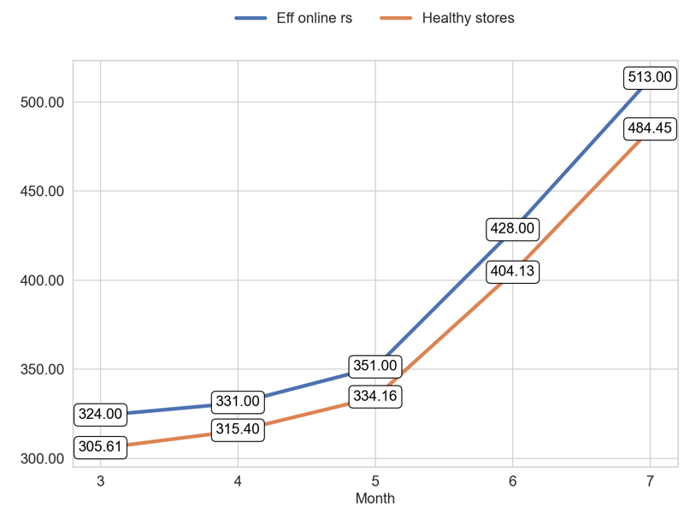
SERVICE
Action Title
Priority 1 -
Example text
Example text

Slide 4
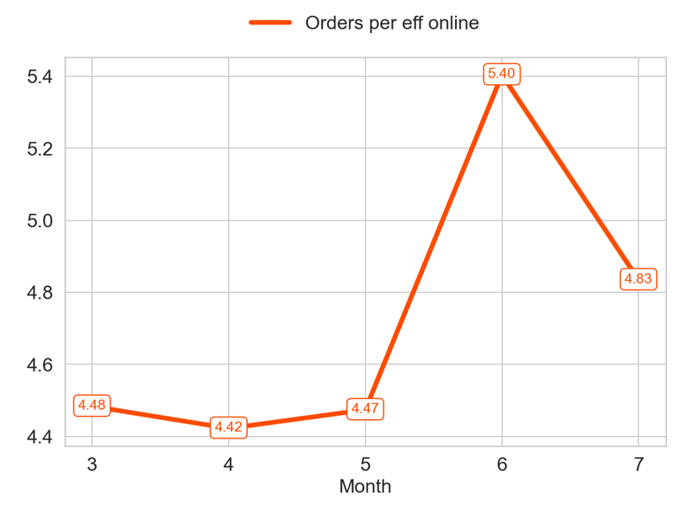
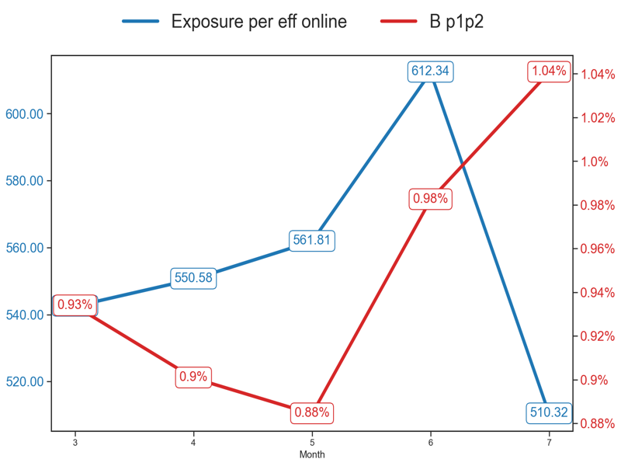
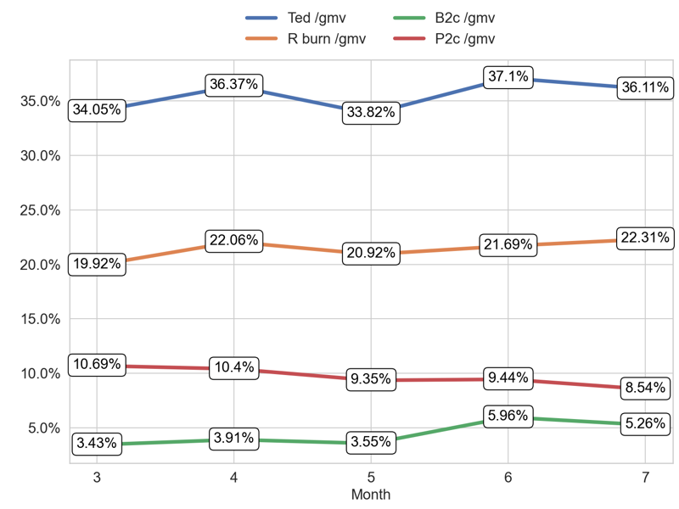
PERFORMANCE
Action Title
Priority 2 -
Insights
Mean over the last 4 months: 4.78
Example text
Example text

Slide 5
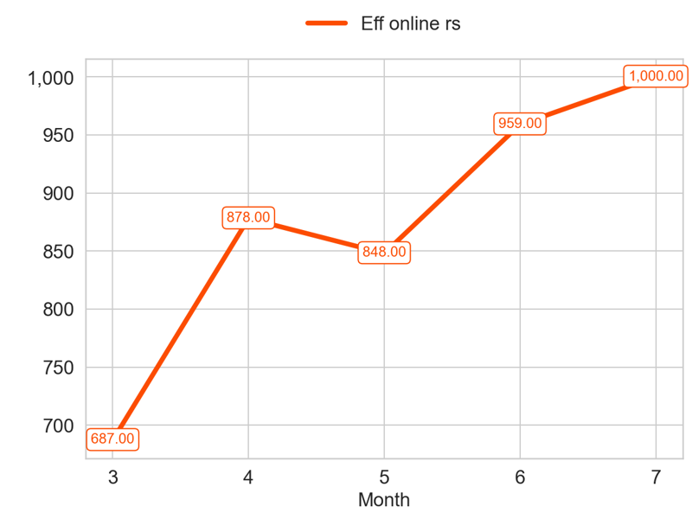
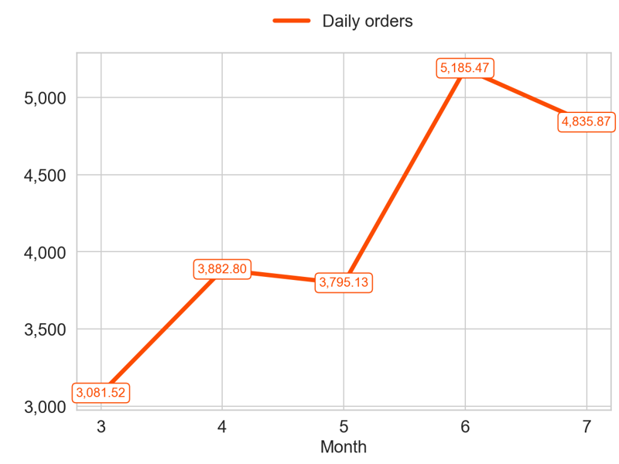
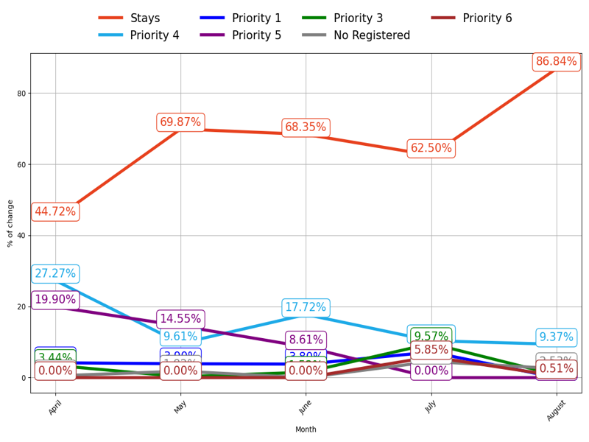
MIXED
Action Title
Priority 2 -
Insights
Mean over the last 4 months: 921.25
Mean over the last 4 months: 4424.82
Example text

Slide 6
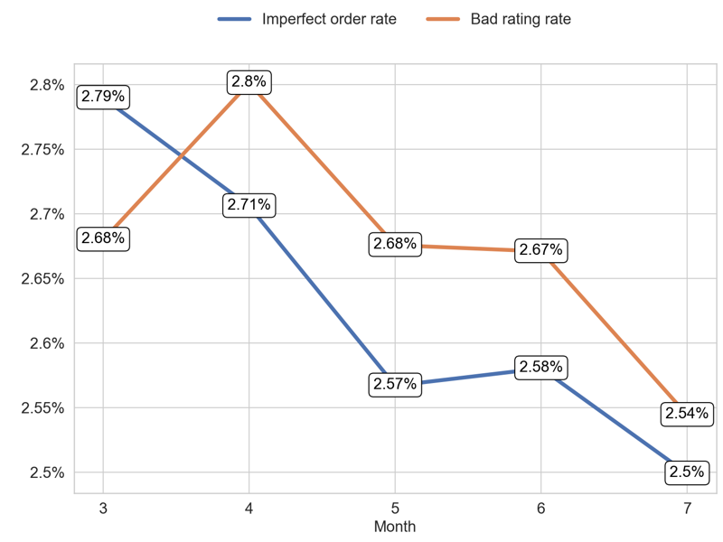
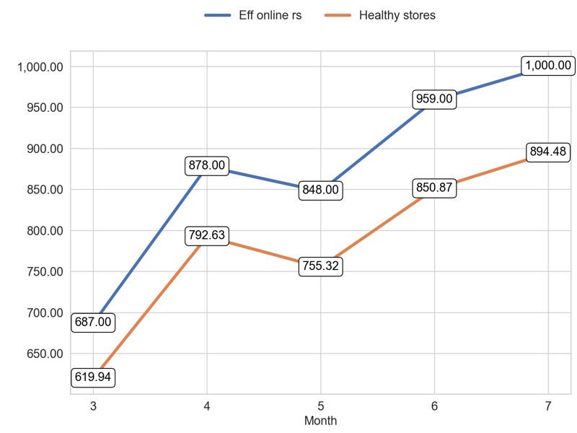
SERVICE
Action Title
Priority 2 -
Example text
Example text

Slide 7
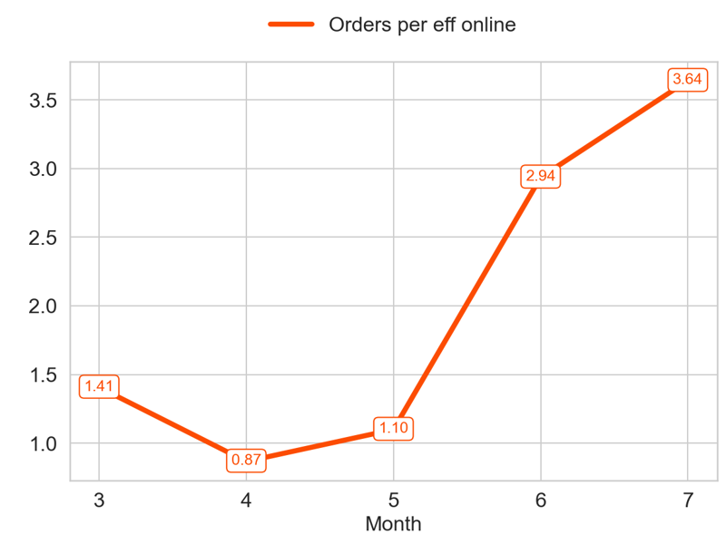
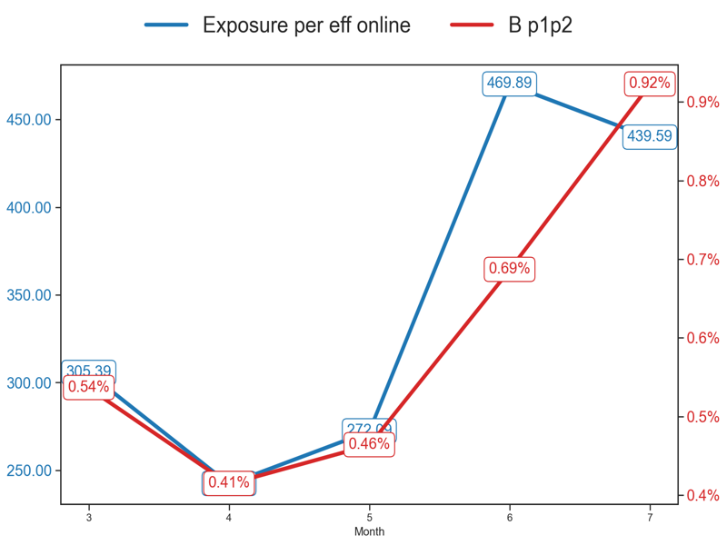
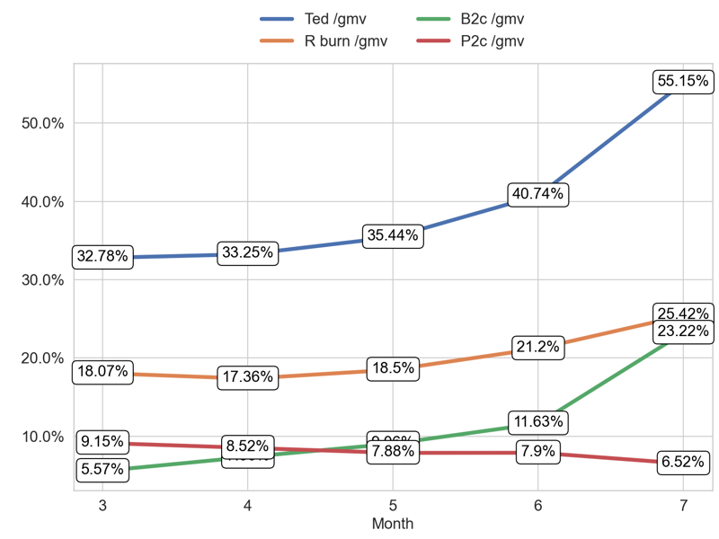
PERFORMANCE
Action Title
Priority 3 -
Insights
Mean over the last 4 months: 2.14
Example text
Example text

Slide 8
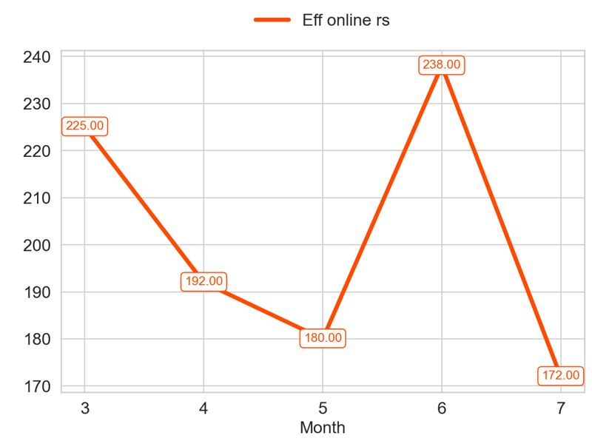
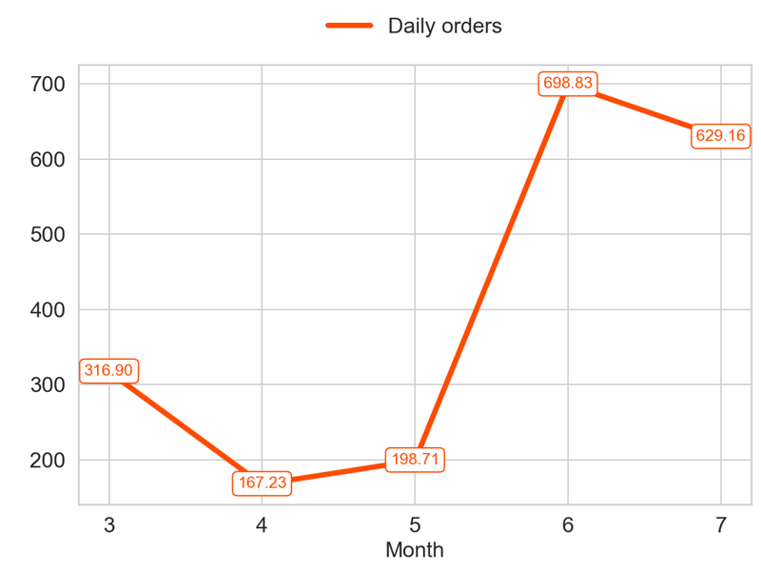
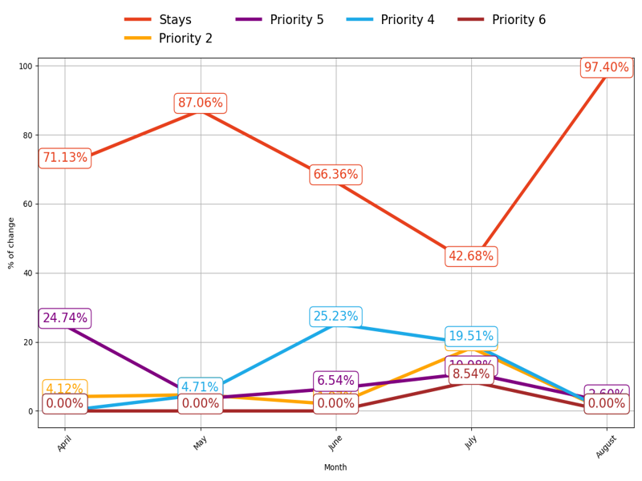
MIXED
Action Title
Priority 3 -
Insights
Mean over the last 4 months: 195.5
Mean over the last 4 months: 423.48
Example text

Slide 9
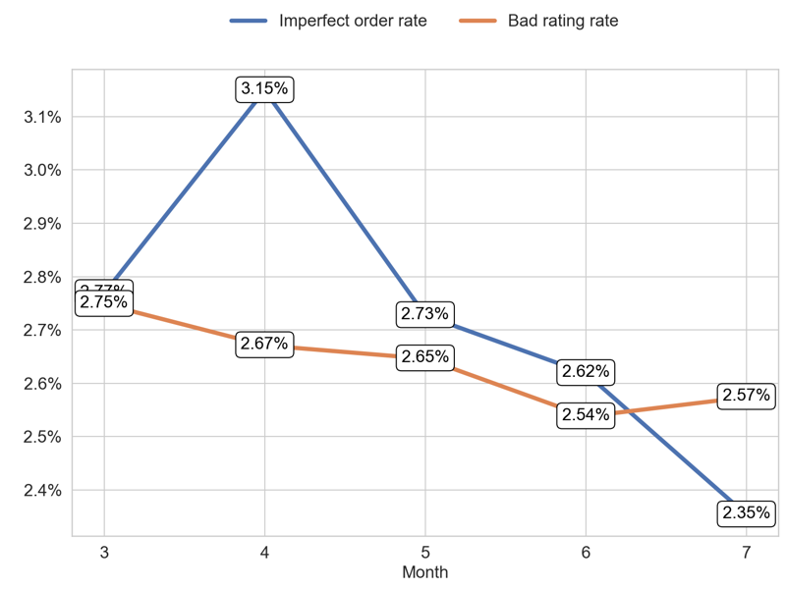
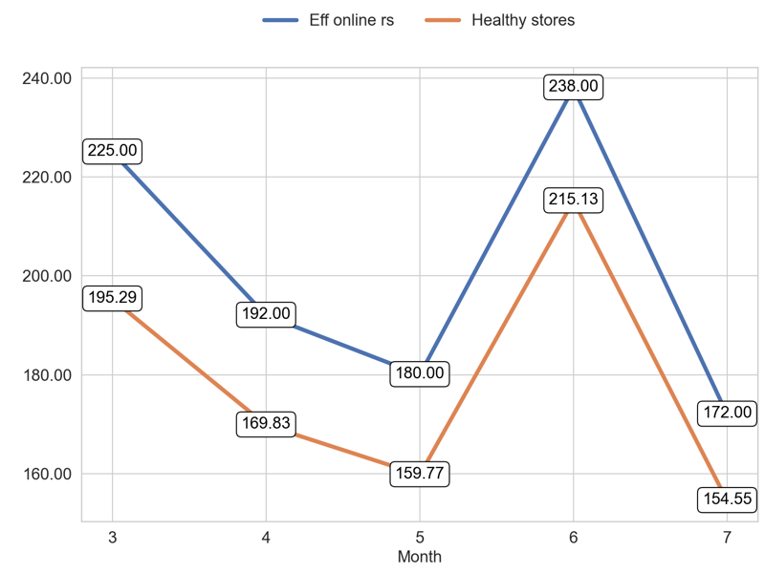
SERVICE
Action Title
Priority 3 -
Example text
Example text

Slide 10
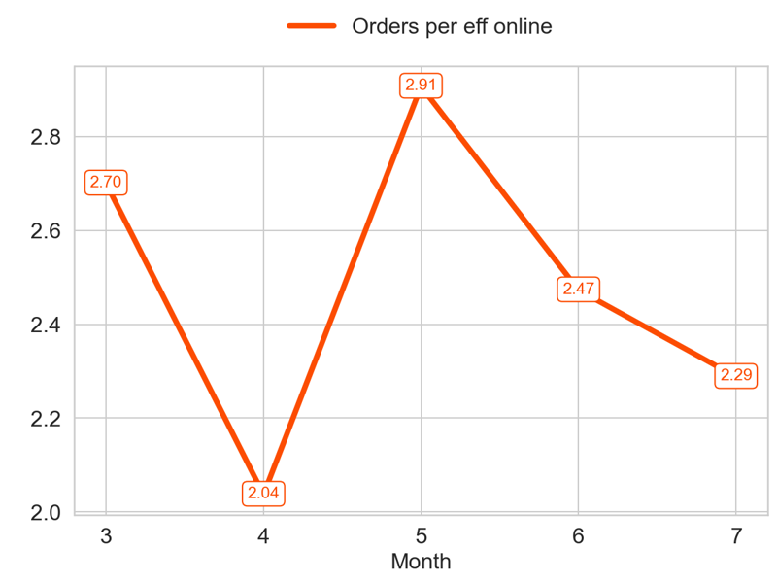
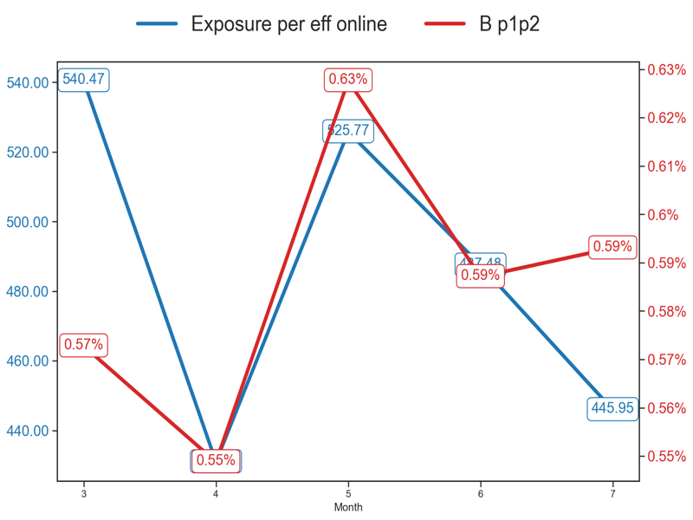
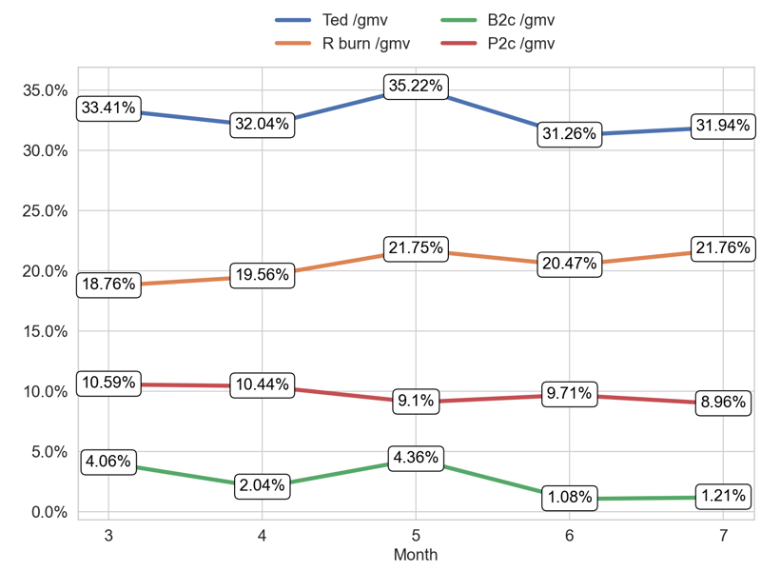
PERFORMANCE
Action Title
Priority 4 -
Insights
Mean over the last 4 months: 2.43
Example text
Example text

Slide 11
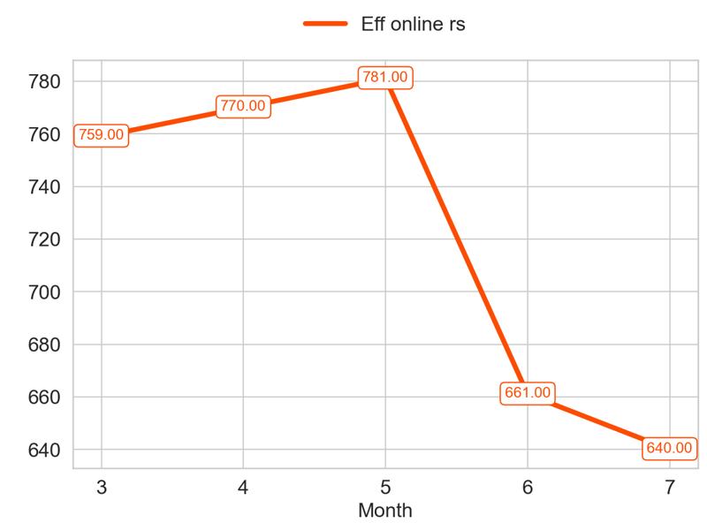
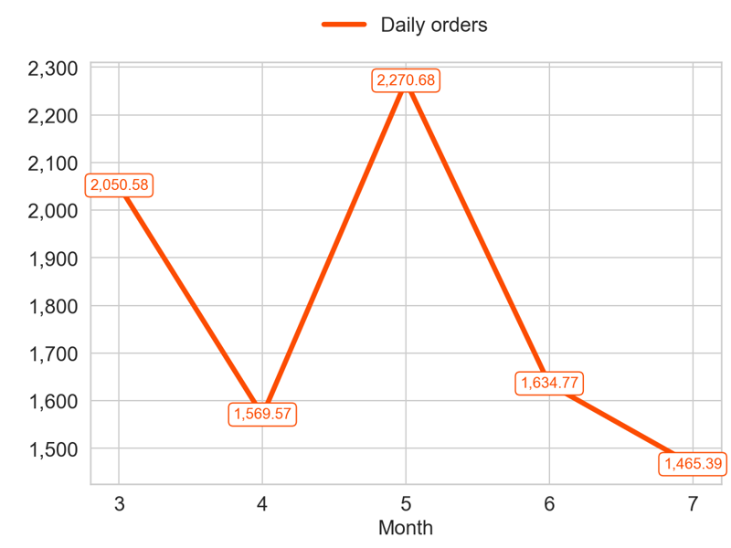
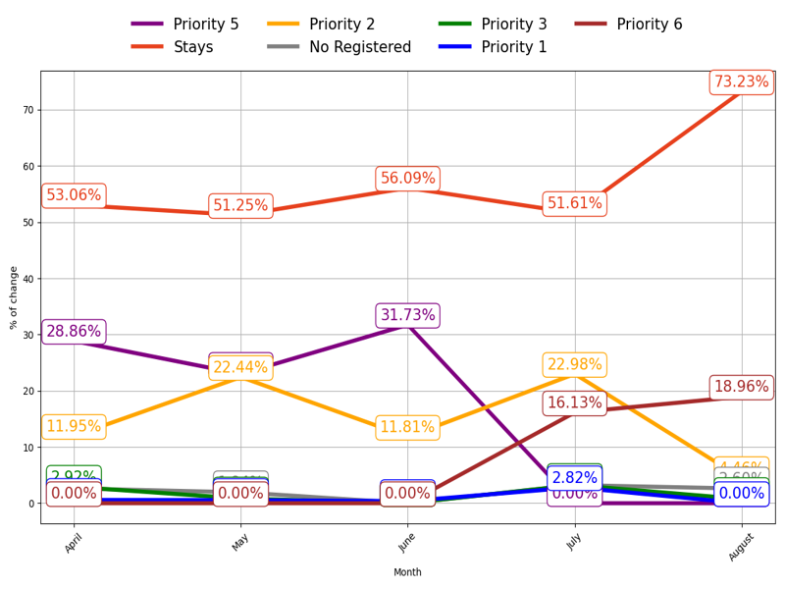
MIXED
Action Title
Priority 4 -
Insights
Mean over the last 4 months: 713.0
Mean over the last 4 months: 1735.1
Example text

Slide 12
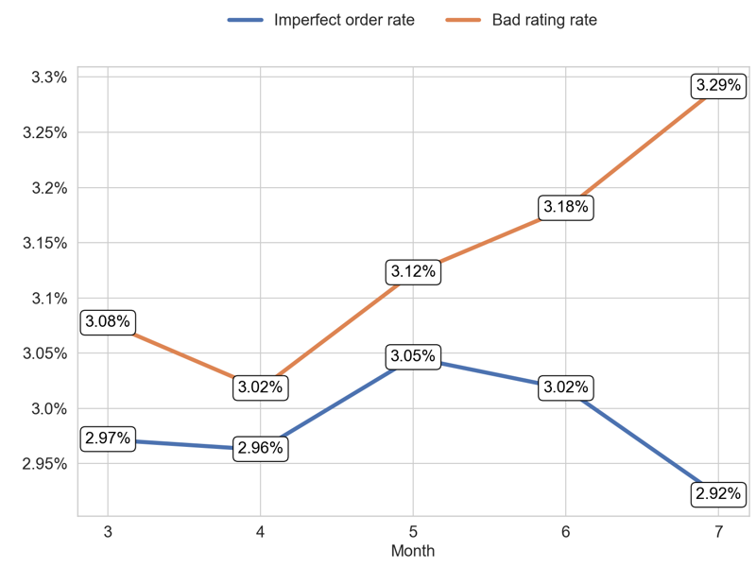
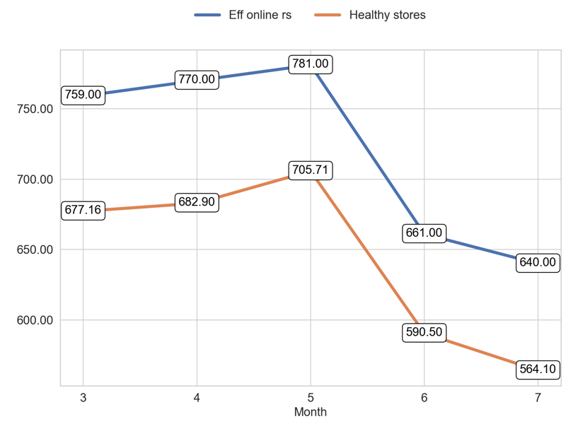
SERVICE
Action Title
Priority 4 -
Example text
Example text

Slide 13
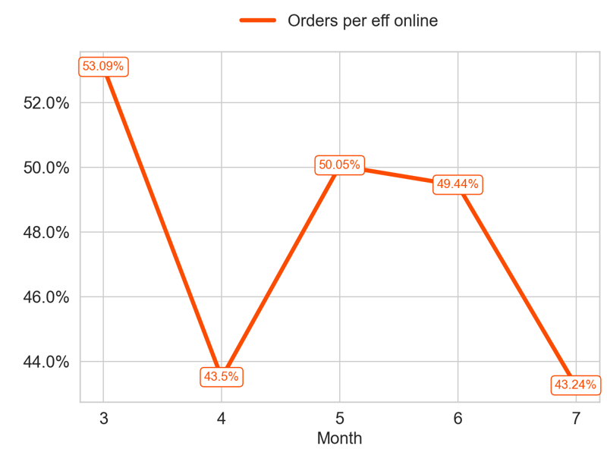
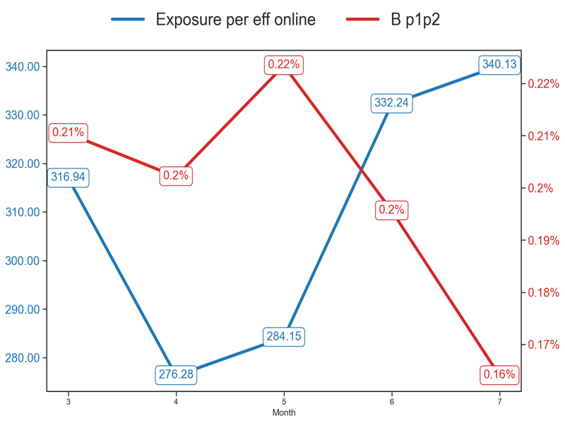
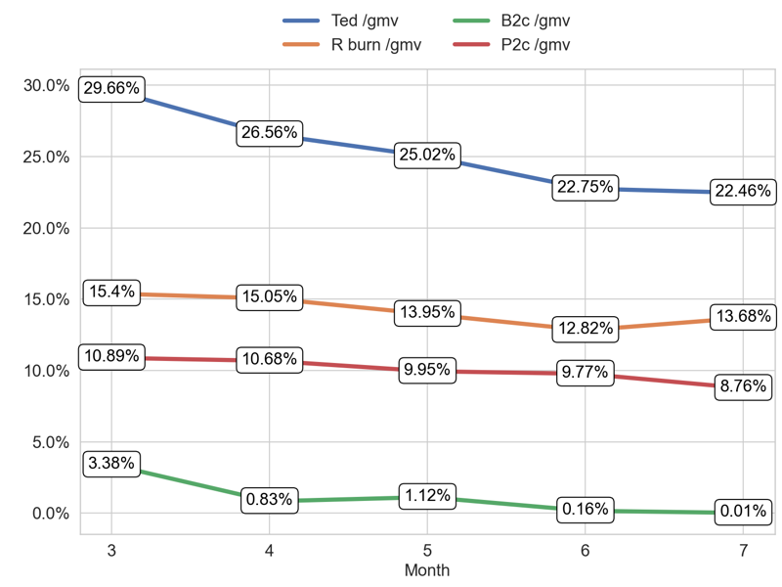
PERFORMANCE
Action Title
Priority 5 -
Insights
Mean over the last 4 months: 0.47
Example text
Example text

Slide 14
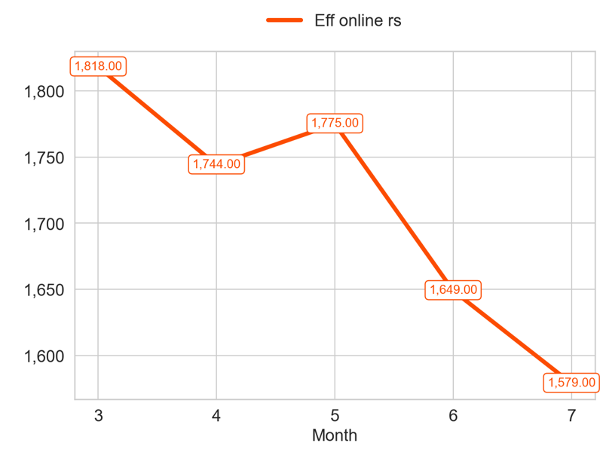
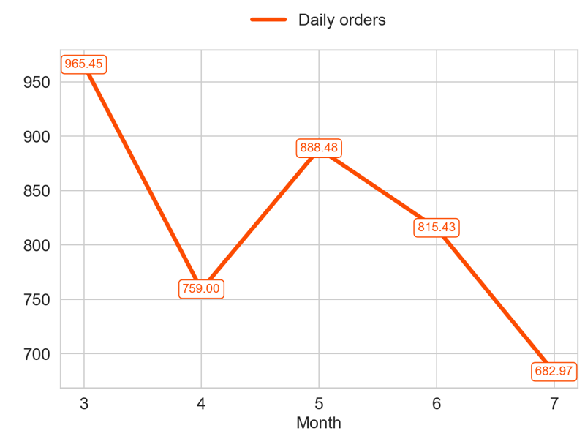
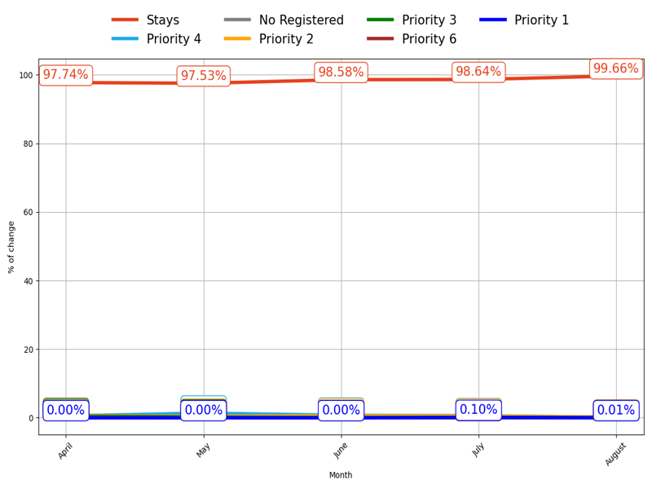
MIXED
Action Title
Priority 5 -
Insights
Mean over the last 4 months: 1686.75
Mean over the last 4 months: 786.47
Example text

Slide 15
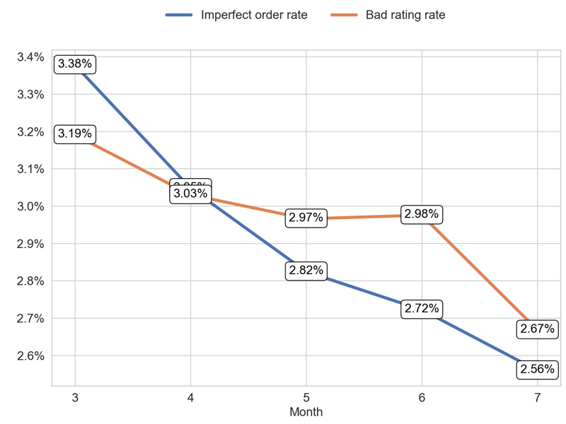
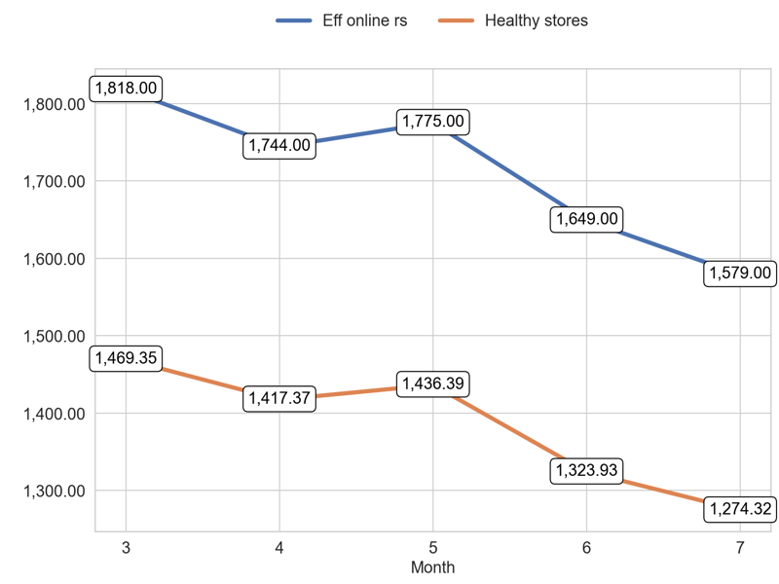
SERVICE
Action Title
Priority 5 -
Example text
Example text

Slide 16

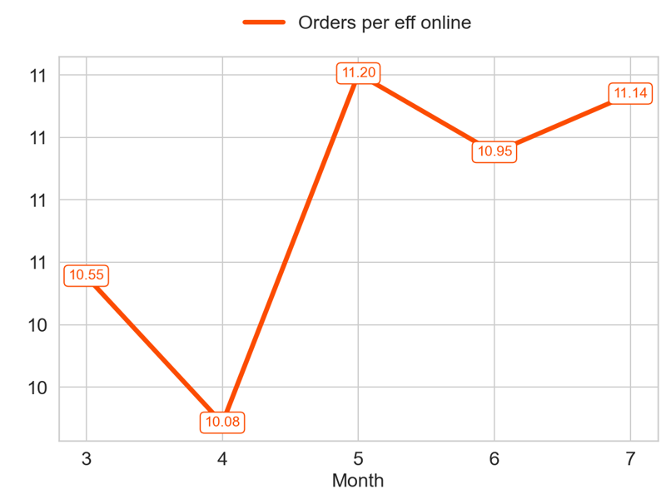
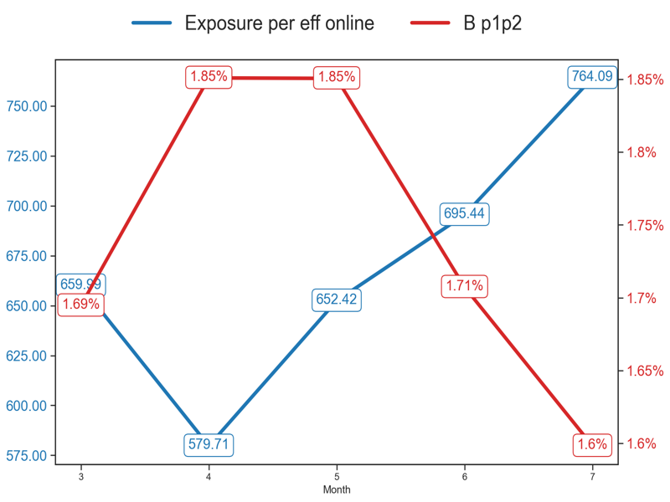
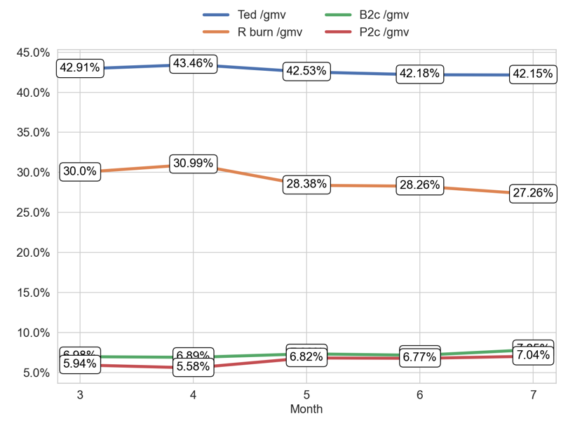
PERFORMANCE
Action Title
Priority 1 -
Insights
Mean over the last 4 months: 10.84
Example text
Example text

Slide 17
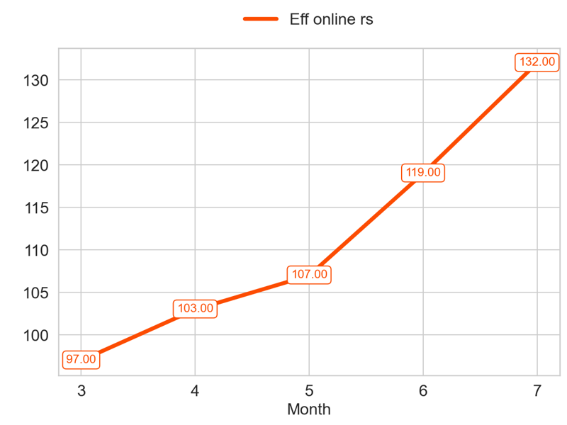
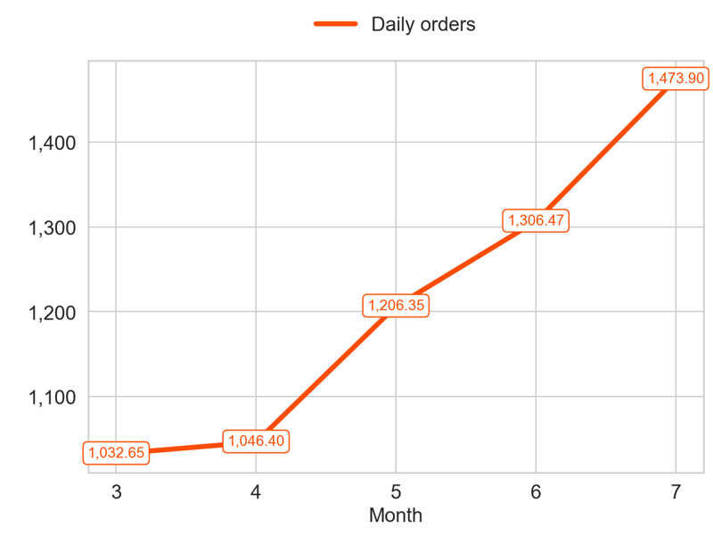
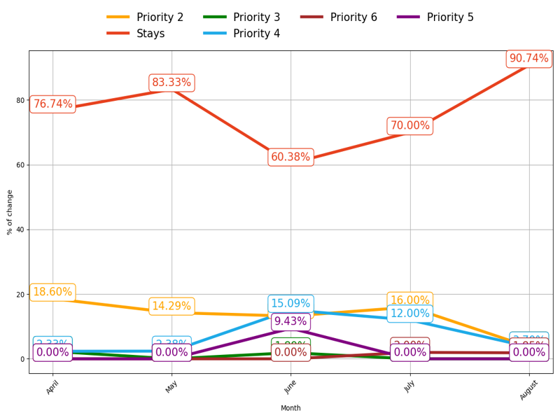
MIXED
Action Title
Priority 1 -
Insights
Mean over the last 4 months: 115.25
Mean over the last 4 months: 1258.28
Example text

Slide 18
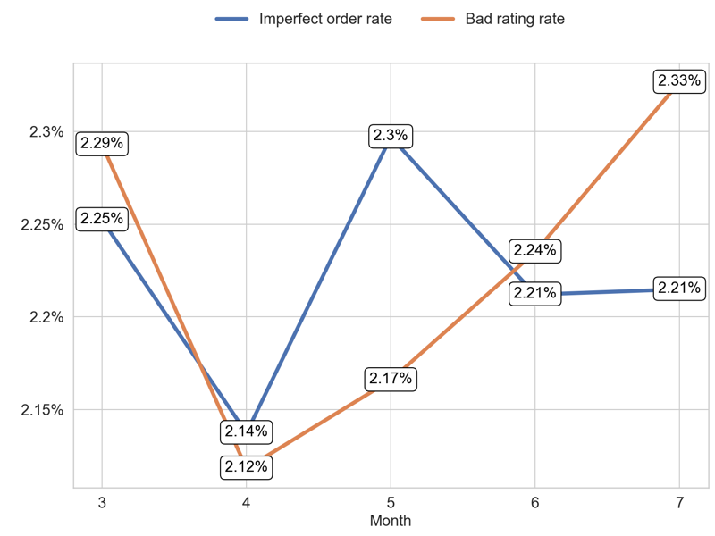
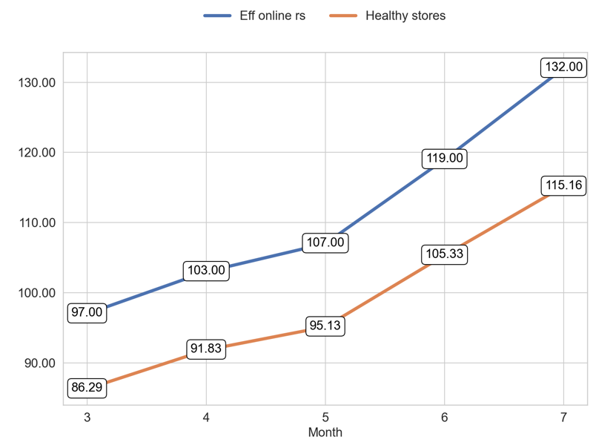
SERVICE
Action Title
Priority 1 -
Example text
Example text

Slide 19
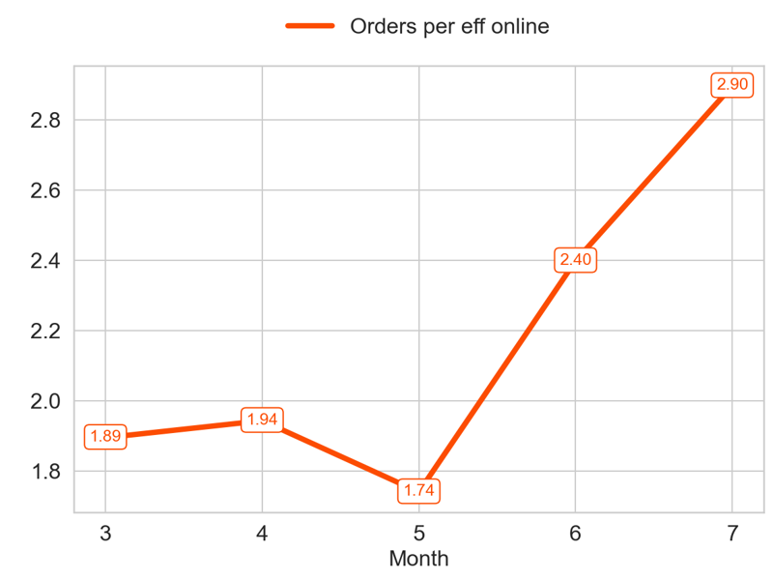
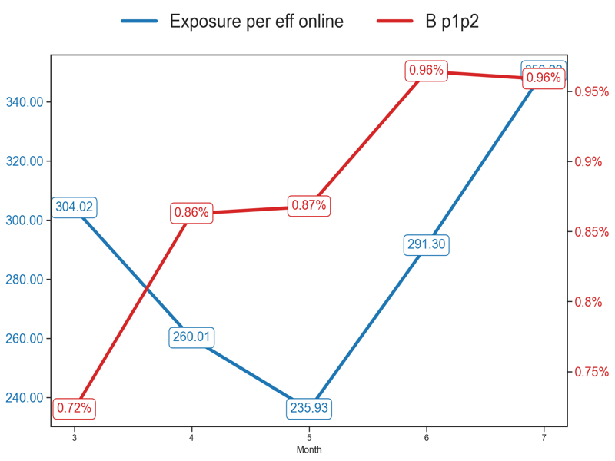

PERFORMANCE
Action Title
Priority 2 -
Insights
Mean over the last 4 months: 2.24
Example text
Example text

Slide 20



MIXED
Action Title
Priority 2 -
Insights
Mean over the last 4 months: 263.0
Mean over the last 4 months: 585.52
Example text

Slide 21


SERVICE
Action Title
Priority 2 -
Example text
Example text

Slide 22



PERFORMANCE
Action Title
Priority 3 -
Insights
Mean over the last 4 months: 0.76
Example text
Example text

Slide 23



MIXED
Action Title
Priority 3 -
Insights
Mean over the last 4 months: 86.25
Mean over the last 4 months: 65.3
Example text

Slide 24


SERVICE
Action Title
Priority 3 -
Example text
Example text

Slide 25



PERFORMANCE
Action Title
Priority 4 -
Insights
Mean over the last 4 months: 1.52
Example text
Example text

Slide 26



MIXED
Action Title
Priority 4 -
Insights
Mean over the last 4 months: 97.25
Mean over the last 4 months: 146.52
Example text

Slide 27


SERVICE
Action Title
Priority 4 -
Example text
Example text

Slide 28



PERFORMANCE
Action Title
Priority 5 -
Insights
Mean over the last 4 months: 0.32
Example text
Example text

Slide 29



MIXED
Action Title
Priority 5 -
Insights
Mean over the last 4 months: 697.25
Mean over the last 4 months: 221.01
Example text

Slide 30


SERVICE
Action Title
Priority 5 -
Example text
Example text

Slide 31




PERFORMANCE
Action Title
Priority 1 -
Insights
Mean over the last 4 months: 14.3
Example text
Example text

Slide 32



MIXED
Action Title
Priority 1 -
Insights
Mean over the last 4 months: 85.0
Mean over the last 4 months: 1211.36
Example text

Slide 33


SERVICE
Action Title
Priority 1 -
Example text
Example text

Slide 34



PERFORMANCE
Action Title
Priority 2 -
Insights
Mean over the last 4 months: 3.11
Example text
Example text

Slide 35



MIXED
Action Title
Priority 2 -
Insights
Mean over the last 4 months: 165.25
Mean over the last 4 months: 515.13
Example text

Slide 36


SERVICE
Action Title
Priority 2 -
Example text
Example text

Slide 37



PERFORMANCE
Action Title
Priority 3 -
Insights
Mean over the last 4 months: 0.81
Example text
Example text

Slide 38



MIXED
Action Title
Priority 3 -
Insights
Mean over the last 4 months: 105.25
Mean over the last 4 months: 64.88
Example text

Slide 39


SERVICE
Action Title
Priority 3 -
Example text
Example text

Slide 40



PERFORMANCE
Action Title
Priority 4 -
Insights
Mean over the last 4 months: 1.69
Example text
Example text

Slide 41



MIXED
Action Title
Priority 4 -
Insights
Mean over the last 4 months: 136.5
Mean over the last 4 months: 235.02
Example text

Slide 42


SERVICE
Action Title
Priority 4 -
Example text
Example text

Slide 43



PERFORMANCE
Action Title
Priority 5 -
Insights
Mean over the last 4 months: 0.35
Example text
Example text

Slide 44



MIXED
Action Title
Priority 5 -
Insights
Mean over the last 4 months: 436.25
Mean over the last 4 months: 154.49
Example text

Slide 45


SERVICE
Action Title
Priority 5 -
Example text
Example text

